Slide 1



KALPATARU INSTITUTE OF TECHNOLOGY, Tiptur
Dept.of Computer Science and Engineering
Internship Progress
Review 1
MIND MATRIX – ANDROID APP DEVELOPMENT USING GEN AI
PRESENTED BY :
Vismaya T M
1KI22CS122
PROGRAM COORDINATOR:
Mr.Tirumal Mutalikdesai Sir

Slide 2

Agenda
Introduction
About Company
Internship Structure
Week 1 Foundation Building
Week 2 Generative Ai Fundamentals
Week 3 Kotlin And Android Basics
Week 4 Industry Insights And Advanced Kotlin
Week 5-7: System Design And Problem Solving
Week 8: Google cloud concept
Week 9-10:Analyze and Working on codelabs
Tools And Technologies Used
Conclusion

Slide 3

INTRODUCTION
This internship focuses on Android App Development using Generative AI.
It helps in learning Kotlin programming and Jetpack Compose UI design.
The program provides hands-on experience in developing mobile applications.
It introduces modern tools and real-world development practices.
The internship improves technical skills, problem-solving ability, and coding knowledge.

Slide 4
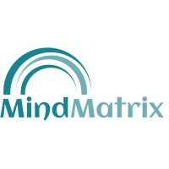

MindMatrix is an education and technology platform focused on skill development.
It aims to bridge the gap between academic learning and industry requirements.
The platform provides AI-powered learning and practical training programs.
It offers hands-on project experience to prepare students for real-world careers.
MindMatrix focuses on developing technical, problem-solving, and industry-ready skills
About Mind Matrix

Slide 5

Week 1: Foundation Building
Setting the Stage
01
Platform Registration
The first week focused on understanding the internship structure and career opportunities in the AI era. I explored the platform and familiarized myself with essential tools and practices.
Set up MindMatrix account
02
Profile Creation
Google Developer profile
Key Activities
Updating LinkedIn profile for professional presence
Creating Google Developer profile
Exploring Google AI Studio capabilities
Learning about Google Cloud Console
03
Tool Exploration
Google AI Studio & Cloud

Slide 6

Internship Structure
The program followed a structured three-phase approach designed to build skills progressively:
Phase 1: Onboarding
Platform registration, developer profile creation, and installing Android development tools
Phase 2: Training
Learning Kotlin programming fundamentals, Generative AI basics, and AI agent concepts
Phase 3: Project Development
Building Android applications and completing practical development tasks

Slide 7

Tools, Technologies & Key Takeaways
Technical Stack
Skills Developed
Kotlin – Primary programming language
Android Studio – IDE
Jetpack Compose – UI framework
Google AI Studio – AI tools
Google Cloud Console – Cloud services
GitHub – Version control
Android app development
Generative AI integration
UI/UX design principles
System architecture thinking
Professional communication
Problem-solving methodologies

Slide 8

Week 2: Generative AI Fundamentals
I learned about Generative AI and the basics of Natural Language Processing (NLP) and how they are used to build intelligent agents.
I understood how AI agents work and how platforms like Salesforce AI and Agentforce help automate tasks such as client support and bookings.
I explored project collaboration tools such as Discord for communication and GitHub/GitLab for managing project repositories.
I learned about the Industry Readiness Framework and the skills companies expect from candidates, such as technical depth and problem-solving ability.

Slide 9
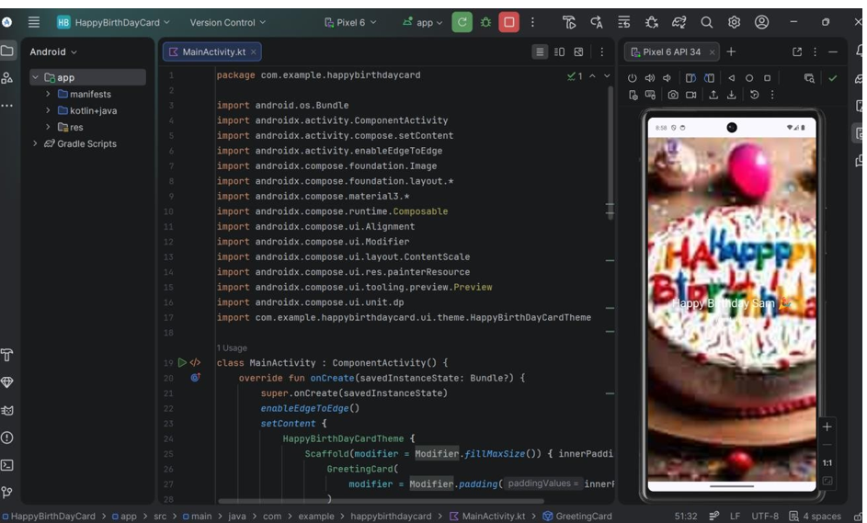
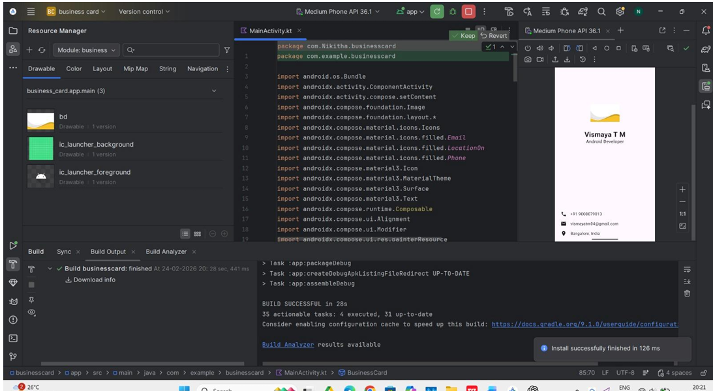








Week 3: Kotlin & Android Basics
Learning Stack
Kotlin programming fundamentals
Android Studio setup and configuration
Emulator setup and testing
UI design with Jetpack Compose
Hands-On Projects
Built several practice applications to solidify concepts:
Hello Android – Basic app structure
Birthday Card – UI customization
Business Card – Layout design

Slide 10
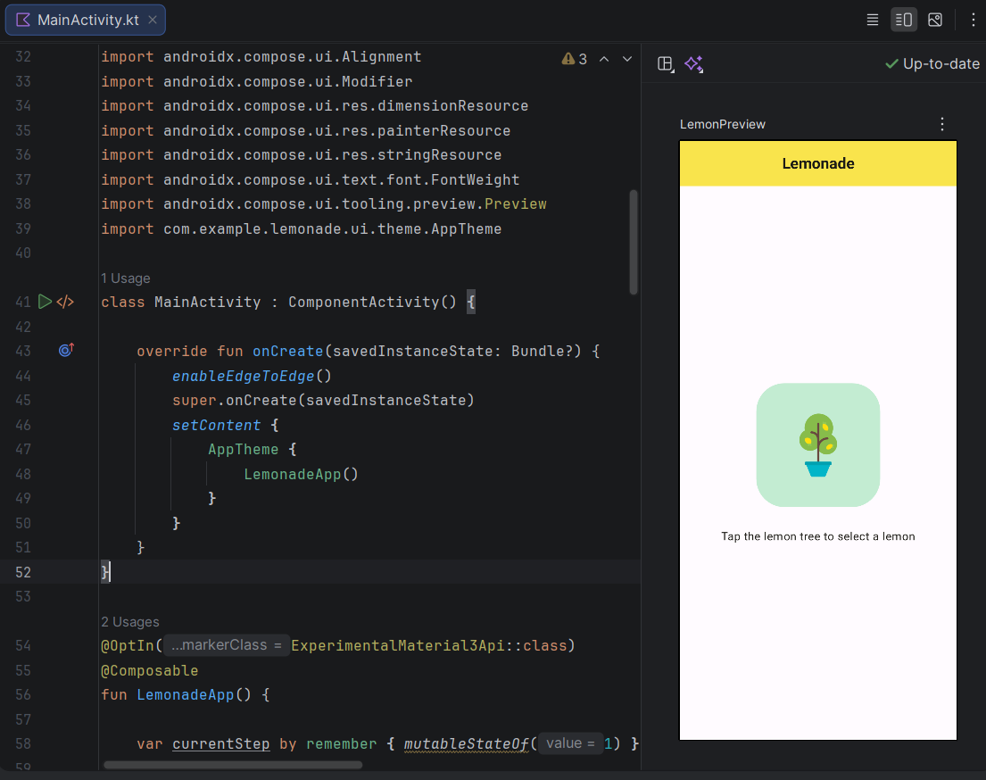

Week 4: Industry Insights & Advanced Kotlin
I learned about the relationship between scope, quality, and time in project development, and how balancing these factors is important in industry projects.
I understood the recruitment and selection process, including aptitude tests, group discussions, technical interviews, and the PREP method for structured communication.
I improved my Kotlin programming knowledge, including concepts like classes, interfaces, lambda expressions, generics, and collections.
I learned problem-solving and decision-making techniques such as Root Cause Analysis, the Plan–Do–Check–Act (PDCA) cycle, and DMAIC for continuous improvement.
I also practiced Android development concepts, including Jetpack Compose UI design, state management, rows and columns, and connecting the emulator with a device.

Slide 11
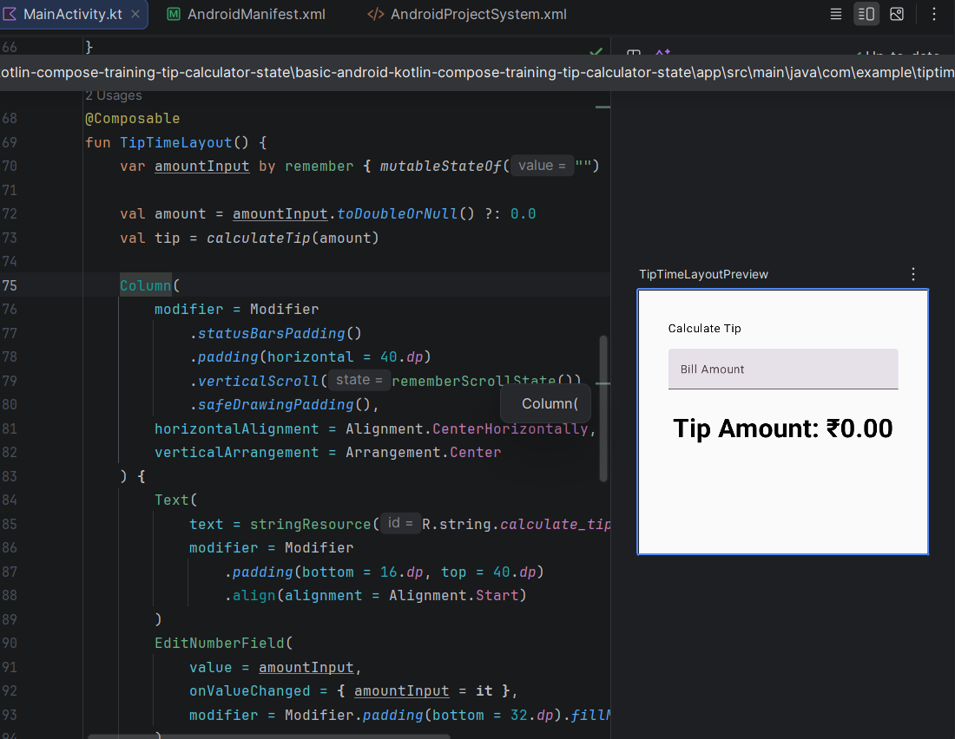

Week 5-7: System Design & Problem Solving
I learned important system design concepts such as Gatekeeper, Doctor, and Critical Path, which help in maintaining system quality and identifying deeper issues.
I practiced Jetpack Compose concepts, including creating lists using LazyColumn, using data classes, and customizing UI elements like icons and padding.
I explored Material Theming and animations in Jetpack Compose to improve the user interface and user experience of Android applications.
I learned problem-solving techniques such as the 5 Whys method and the Ishikawa diagram to identify root causes of problems.
I also understood the importance of accessibility, UI consistency, and performance optimization while developing Android applications.

Slide 12

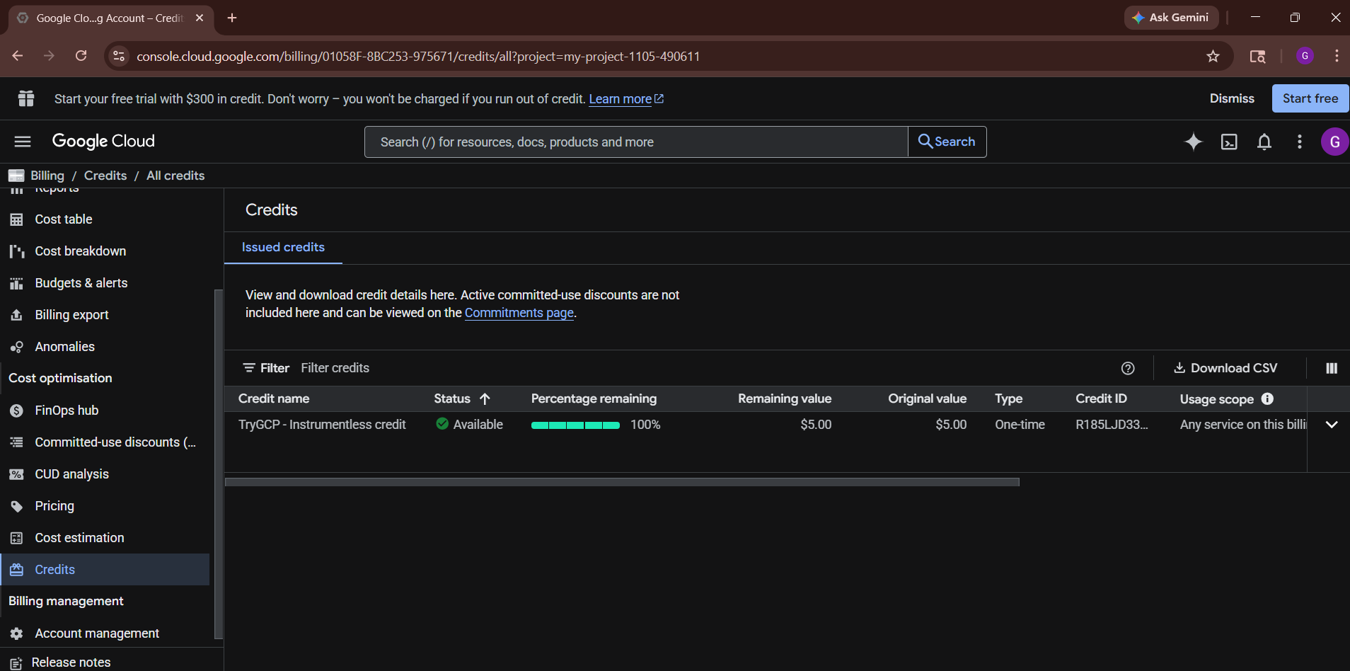
Week 8: Google Cloud Concept
I learned the fundamentals of Google Cloud, including its core services such as Compute Engine, Cloud Storage, and Cloud Functions, which are essential for building scalable applications.
I explored cloud computing concepts like Infrastructure as a Service (IaaS), Platform as a Service (PaaS), and deployment models to understand how applications are hosted and managed in the cloud.
I practiced working with Google Cloud Console, creating virtual machines, and managing resources efficiently.
I gained knowledge about cloud security practices, including Identity and Access Management (IAM), data protection, and secure authentication methods.
I understood the importance of scalability, reliability, and cost optimization while designing cloud-based solutions.

Slide 13
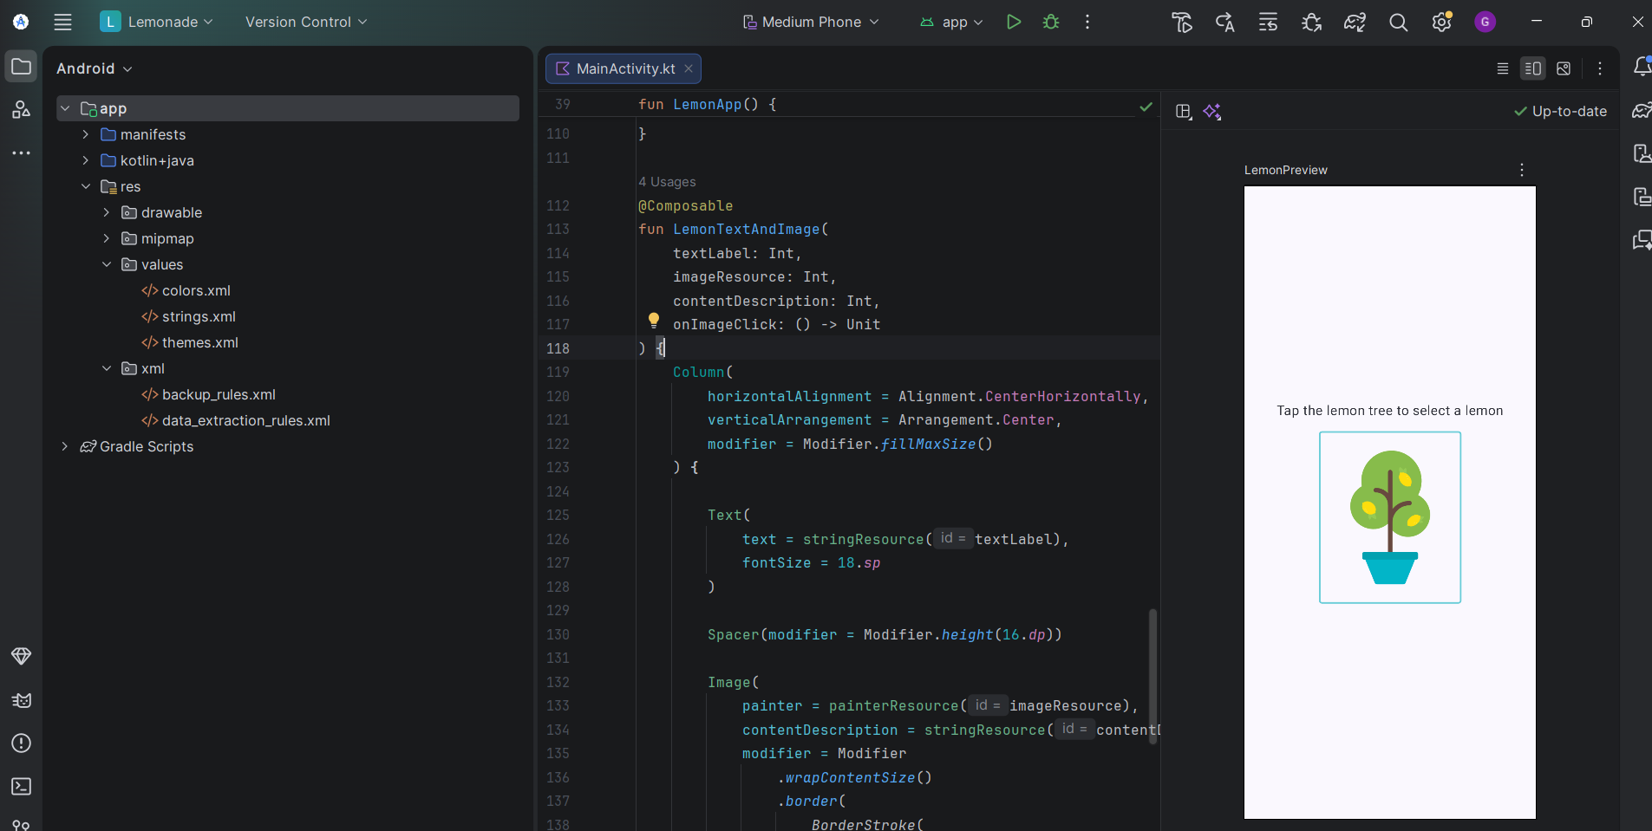
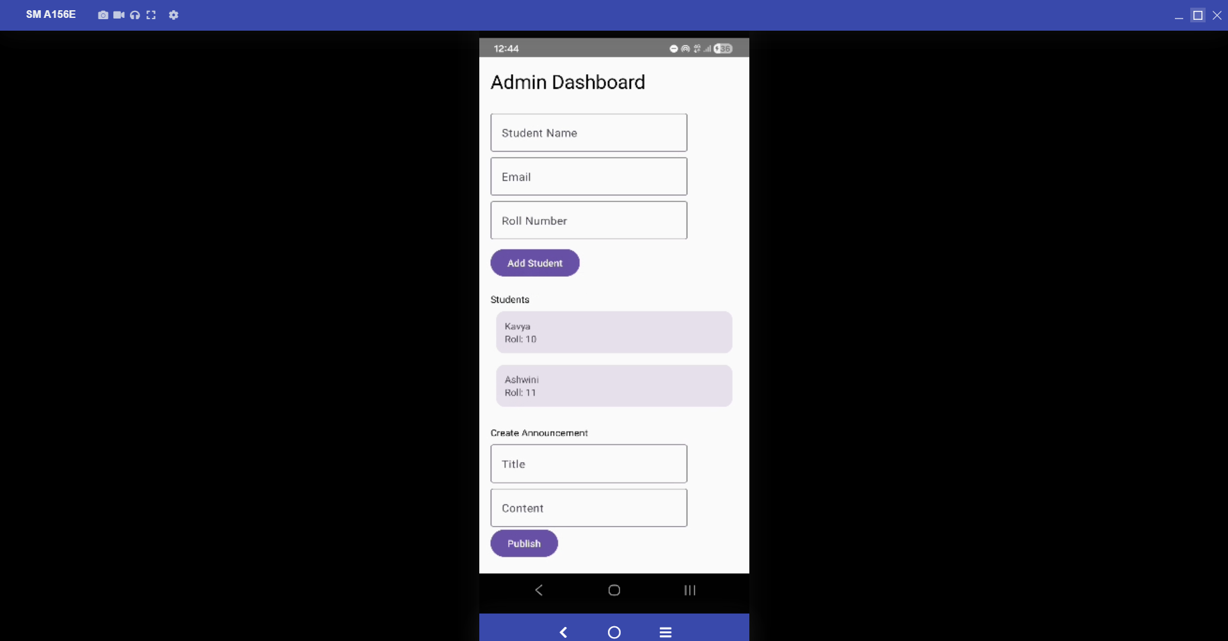
Week 9-10:Analysing and working on Codelabs
I worked on multiple codelabs from Android Developers that helped me understand advanced Jetpack Compose concepts like UI design, state management, and app architecture. These pathways focus on building real-world Android applications step by step
Through these pathways, I learned how to create interactive UI components, manage user input, and handle application state effectively, which is essential for building dynamic Android apps
I also gained knowledge of Kotlin programming concepts such as collections, higher-order functions, and data handling, which are widely used in modern Android development.
Additionally, I explored Material Design, animations, and accessibility features to enhance user experience and build visually appealing and user-friendly applications.

Slide 14

Conclusion
This internship helped me gain practical knowledge in Android app development, Kotlin programming, and Generative AI.
I also learned about industry expectations, problem-solving, and professional skills.
Overall, the experience improved my technical abilities and gave me better understanding of real-world software development.

